Slide 1




STUDENT
INTEREST
Presented by: NUMEER QADRI

Slide 2

INTRODUCTION
The Student Interest System is a comprehensive framework designed to identify, analyze, and support the varied interests of students within an academic environment.
It is a dynamic tool that aims to enhance the educational experience by acknowledging and integrating students' passions, hobbies, and curiosities into their learning journey.

Slide 3


Technologies used
Django
Html
Css
Bootstrap
Ajax
JavaScript

Slide 4





Reason for using technologies
Django
Ajax
It delivers a robust foundation for building secure and scalable web applications.
Streamlines common tasks, allowing you to focus on core features and functionality.
Simplifies database interactions, reducing the need for manual SQL queries.
Offers built-in authentication, admin panel
Enables seamless data retrieval and updates without full page reloads, enhancing user experience.
Allows users to interact with the application while data is fetched in the background, leading to a more fluid and responsive feel.
DataTables is a jQuery plugin used to display and manage large sets of tabular data with features like sorting, searching, and pagination
Html/Css/Bootstrap
HTML provides the structure of web pages.
CSS handles styling and visual elements.
Bootstrap offers a pre-built framework for responsive layouts, saving time and effort in creating a mobile-friendly design.
JavaScript
Works seamlessly with AJAX to enable asynchronous data retrieval and updates
Handles the chart plotting and populating tables with dynamically

Slide 5


Templates, Colors and Fonts
I use html/Css/bootstrap template for login page only with modification according to my project
01
I used default color for the basic text , However dashboard contains the combination of different colors e.g. green, red , blue and random colors for charts
02
I used the default fonts for my project . However I used different font size to enhance the readability for user like 46,42 etc.
03

Slide 6

APPLICATION
FLOW

Slide 7
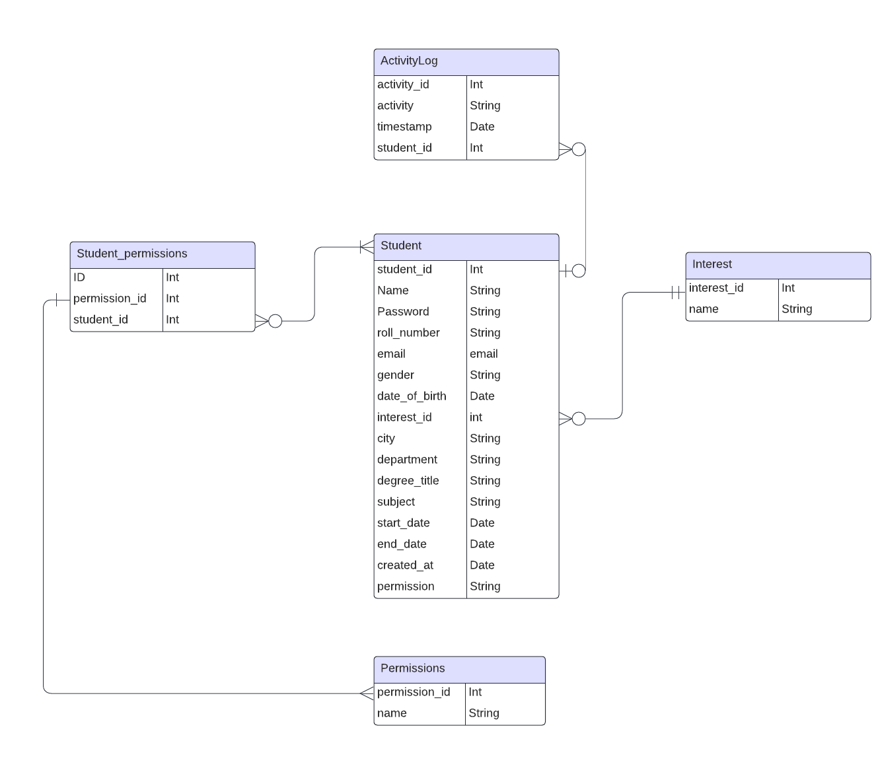
Entity Relationship Diagram

Slide 8
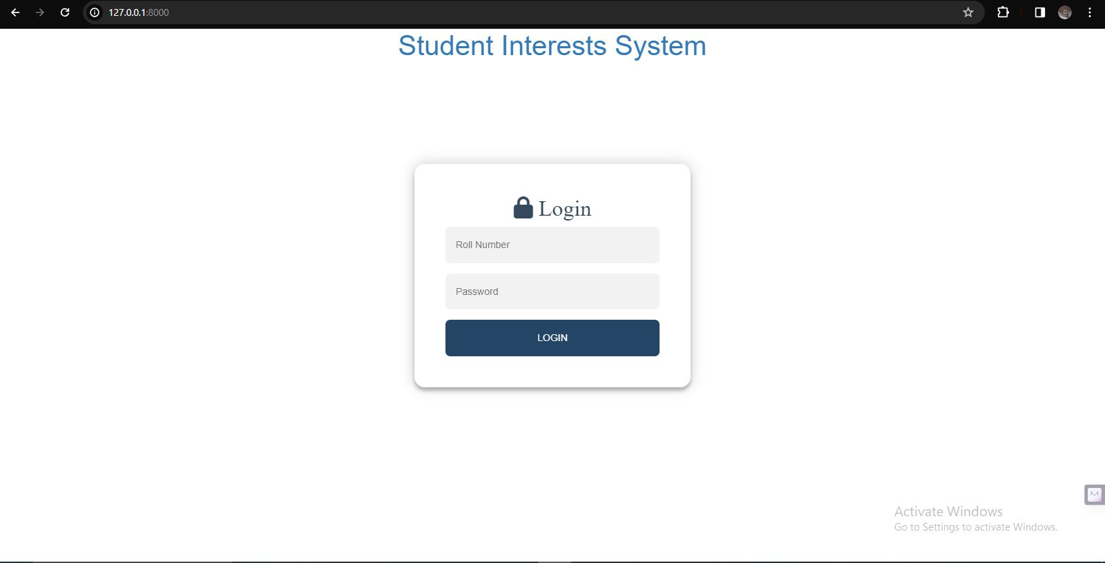

Sign In
On running the app the default page is sign in page user can enter their roll no and password to login to the system.

Slide 9
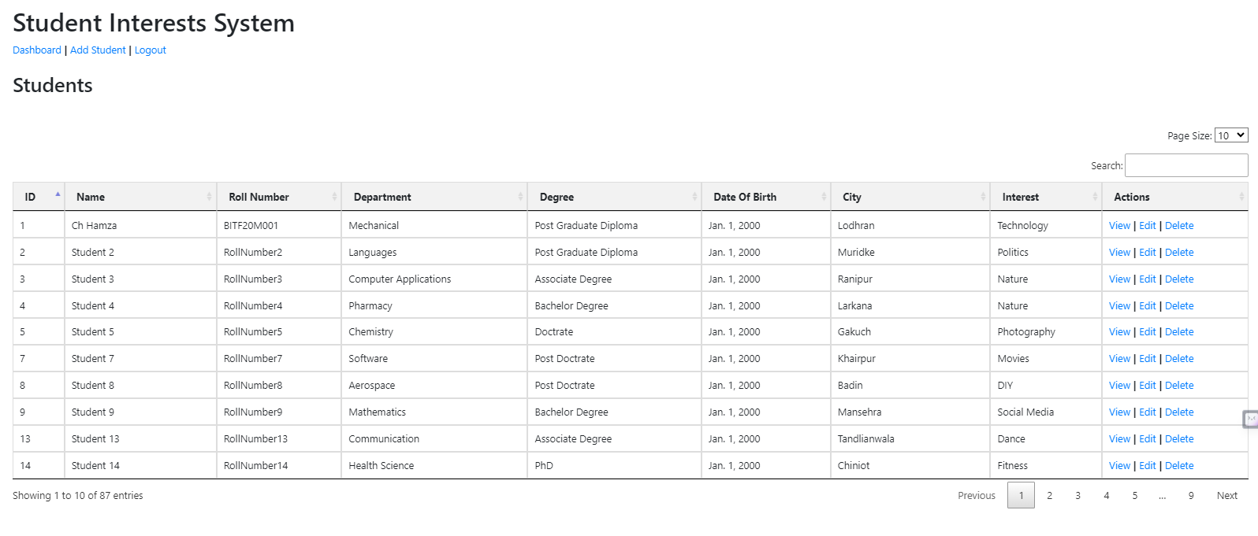
Student List
After login successfully user is rendered to student list table here user can add, view update and delete the information if the user have permissions otherwise user got an error.
User can also search for the record.

Slide 10
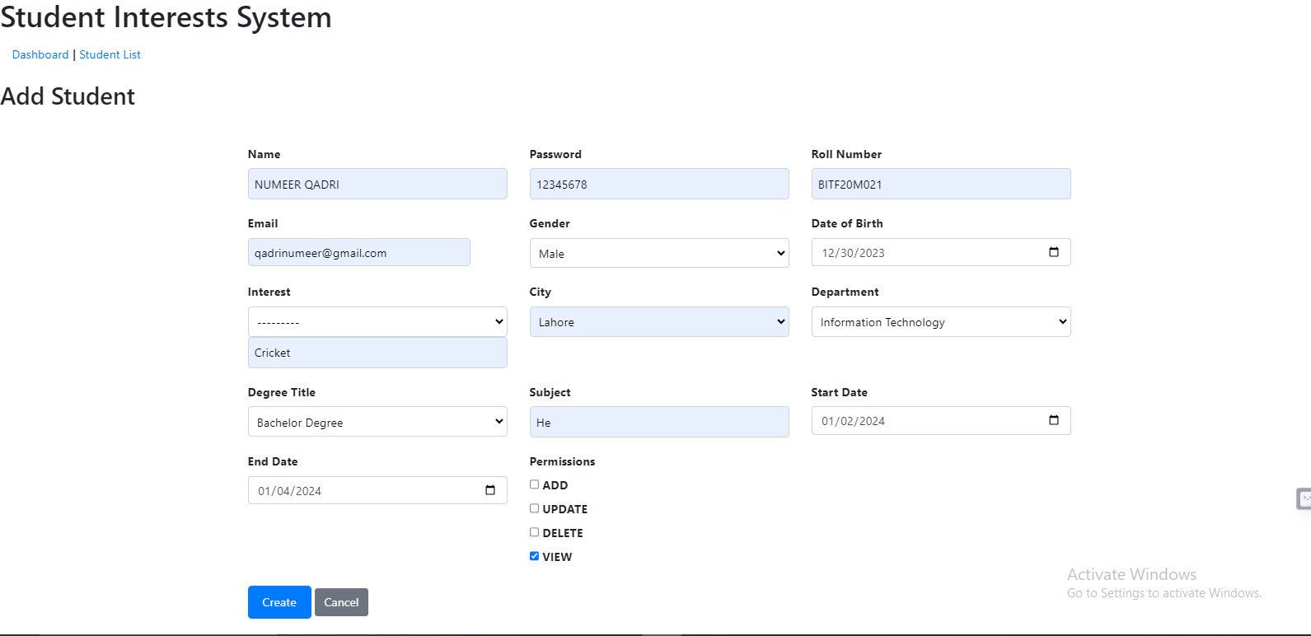
Add Student
If the user have permission user can add a new record. If the user interest is not in a interest dropdown user can select the ------- so that new interest field is visible user can type a new interest. The permissions field is optional.

Slide 11
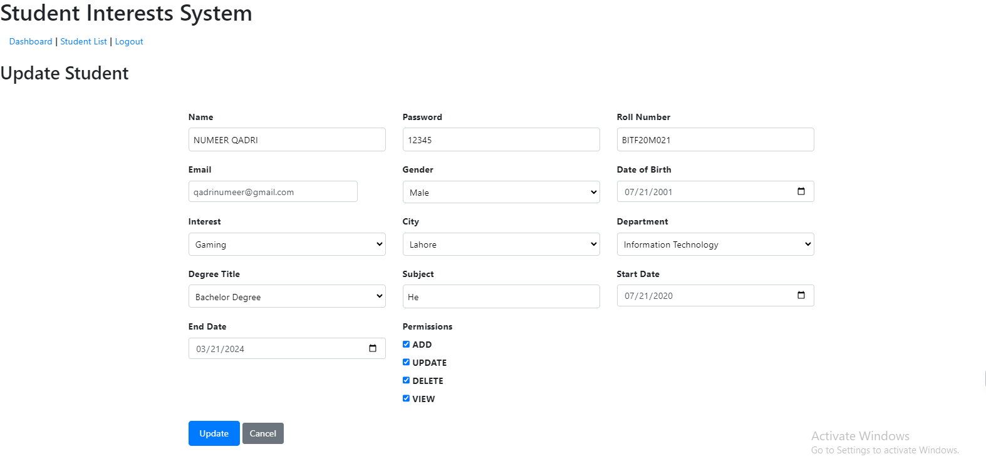
Update Student
If the user have permission user can update a existing record. All the fields are pre-filled user can perform necessary changes.

Slide 12
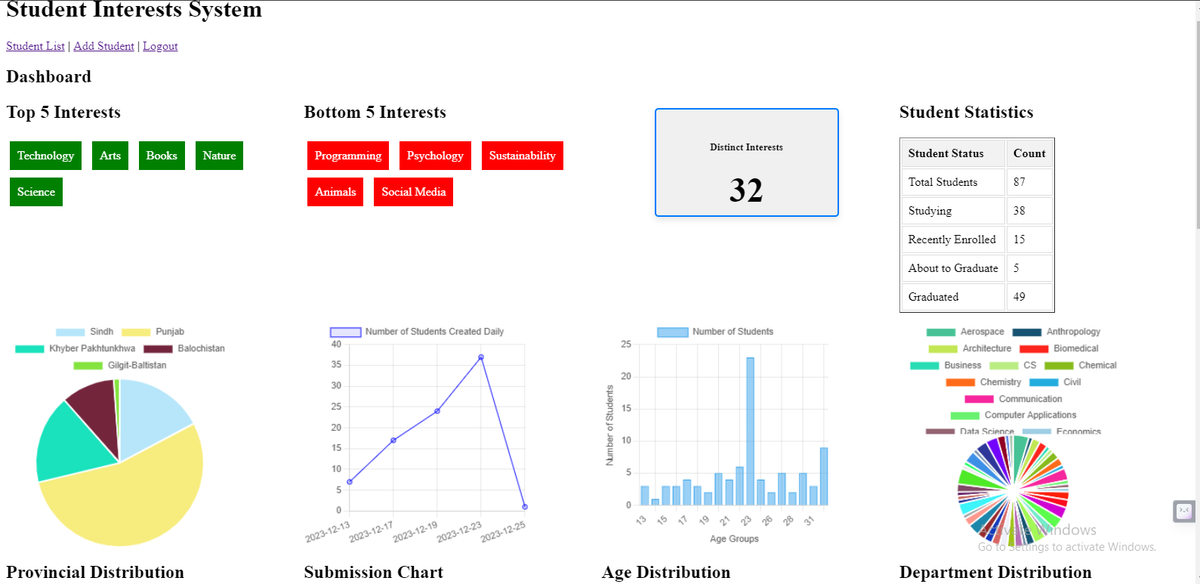
Dashboard
Dashboard contains the various charts and activities performed by users
Provincial distribution is distribution according to the province actually I am storing the cities but when displaying the chart cities are matched to their provinces and count of that province increase

Slide 13
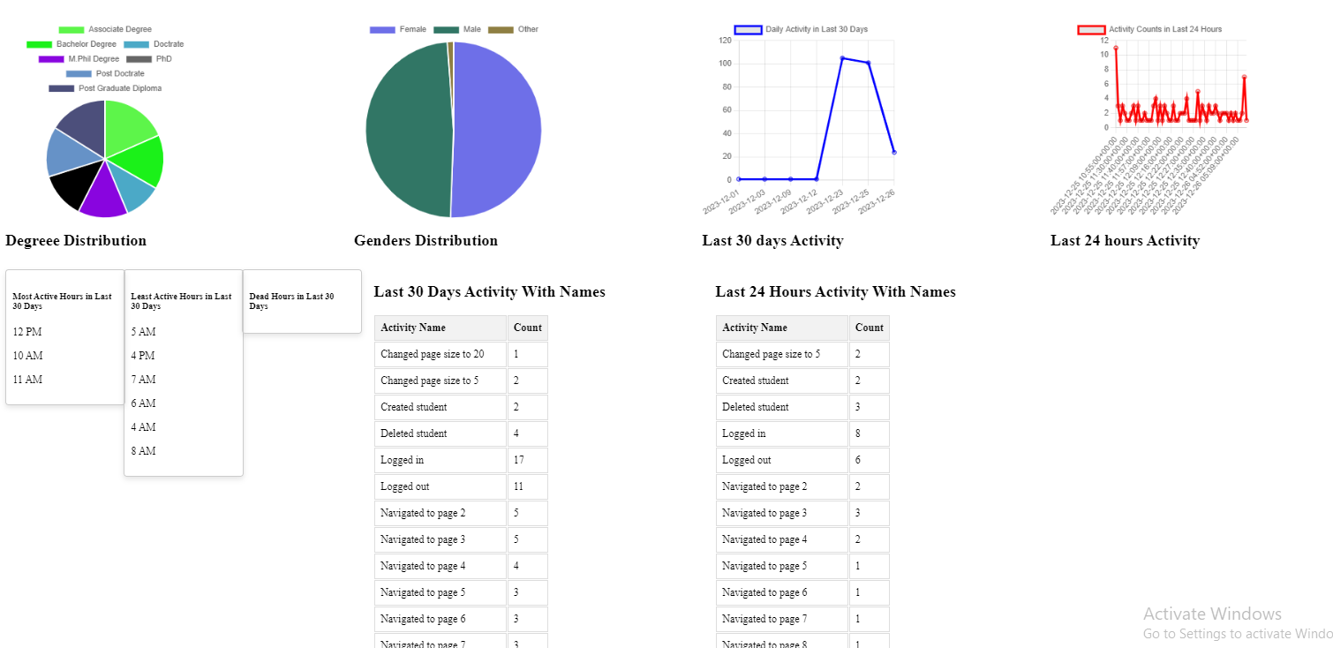
Dashboard
Continuation of previous slide it contains the charts of activities, active hours table and table of activities performed in last 24 hours and 30 days with names

Slide 14
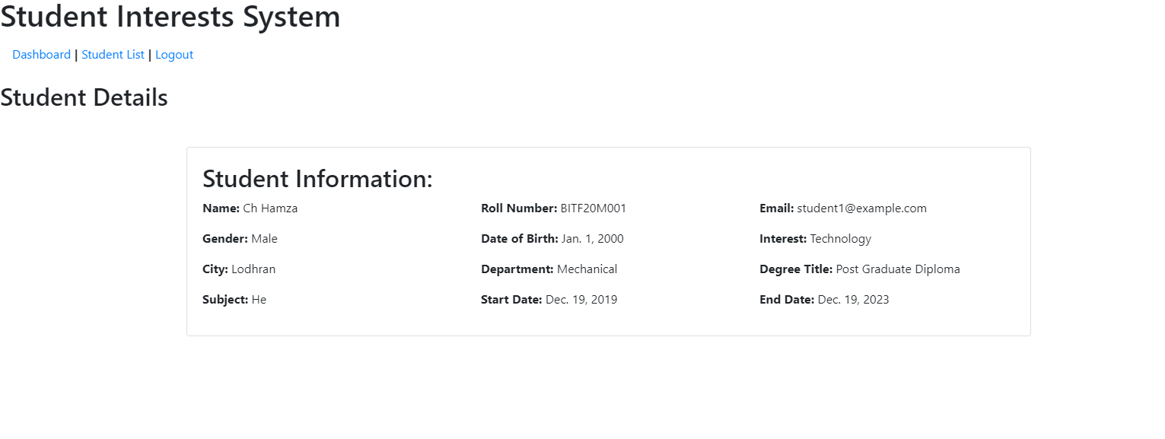
View details
If user have permission user can view the details of specific record

Slide 15
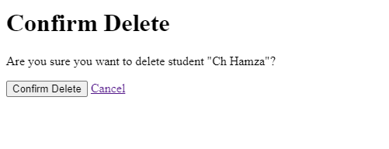
Delete
If user have permission user can delete record

Slide 16
Thank's For Watching

